Slide 1

RU Baked?
Kyle Rapps | Charles London | Nick Pieros
Scott Jeffrey | Justin Pilla | Ryan Smith

Slide 2
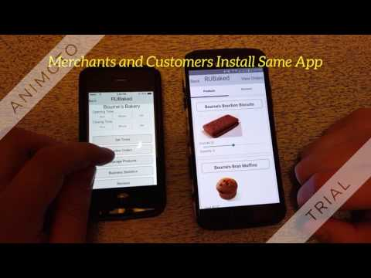
RU Baked Preview

Slide 3
RU Baked? Goals
Develop an application that will run on mobile devices.
Provide a convenient and quick interface for users to order goods.
Application powered by a RESTful service
A database to save user information in order to provide a more streamlined experience.
Provide a digital venue for merchants to sell their goods.

Slide 4
RU Baked? Features
Buyer Features
SMS notification of orders
Rating system of merchants to ensure quality of service
All digital payment platform for ease of access
Merchant Features
Hours easily modifiable to accommodate last minute schedule changes
Uniform format for merchants ensures quality experience for customers
Can set delivery options if available
Build Your Own Menus

Slide 5

React Native
Facebook Developed Technology
Cross Platform Development using React
Write Once, run on iOS and Android
No need for recompiling new code, supports hot reloading
Easy to implement Javascript (ES6)
Ver. 0.35 in September, Ver 0.39 in December

Slide 6
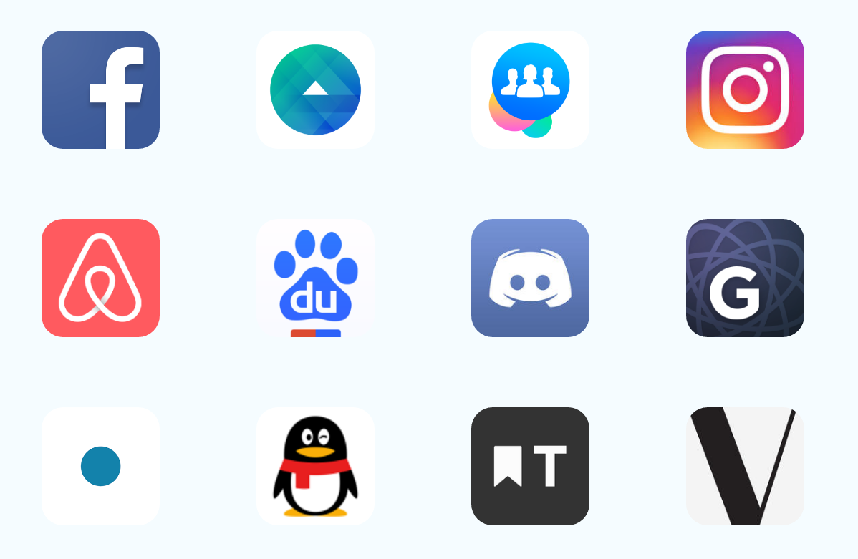
React Native is a Growing Platform
Many popular services are moving to React-Native or are build on the platform including:
Facebook
Instagram
Airbnb
Discord
Soundcloud Pulse
And many more: https://goo.gl/rNUi09

Slide 7
Cross Platform Development with React Native:

Slide 8
Below is a sample explaining the different ways components will be interpreted by Android or iOS
import React, { Component } from 'react'; import { Image, ScrollView, Text } from 'react-native'; class AwkwardScrollingImageWithText extends Component { render() { return ( <ScrollView> <Image source={{uri: 'https://i.chzbgr.com/full/7345954048/h7E2C65F9/'}} /> <Text> On iOS, a React Native ScrollView uses a native UIScrollView. On Android, it uses a native ScrollView. On iOS, a React Native Image uses a native UIImageView. On Android, it uses a native ImageView. React Native wraps the fundamental native components, giving you the performance of a native app, plus the clean design of React. </Text> </ScrollView> ); }}

Slide 9
iOS vs Android Development
Android development:
Nuclide IDE (very buggery, not recommended)
Any JavaScript editor
iOS development:
Deco IDE (recommended)
Any JavaScript editor
Run Android app:
react-native run-android
Android Studio
Run iOS
react-native run-ios
Xcode

Slide 10
RU Baked? Navigation Example
_navigateRegistration(name, type){
this.props.navigator.push({
component: RegisterScene,
passProps: {
name: name },
type: type
})

Slide 11
RU Baked? Render Example
class InformationInput extends Component{
constructor(props){
super(props);
this.state = {text: ''};
}
render(){
return (
<TextInput style = {styles.textinput}
onChangeText = { (text) => this.setState({text})}
onSubmitEditing = {dismissKeyboard}
secureTextEntry = {this.props.secure}
/>
);

Slide 12
NPM
Package manager for Javascript, required for React Native
Must run ‘cd /.../PROJECT && npm install’ on any new project
Npmjs.com hosts a wide variety of packages and libraries available for download
Contributed by users
Installing new packages is as simple as:
cd /.../PROJECT && npm install package-name
Import package within JavaScript file

Slide 13
SMS Integrations with Twilio:

Slide 14

Twilio
Cloud Communications Platform
Convenient & Easy to Implement RESTful API
Send & Receive SMS messages with code
Utilized by merchants when an order is place

Slide 15
Twilio Sample Call
client.messages.create(body=sms_str, to=user_phone.replace('-', ''), from_="+19083325066")
client.messages.create(body=sms_str, to=phone.replace('-', ''), from_="+19083325066")
return self.make_response_from_sqlalchemy(new_order), 201 # HTTP 201 CREATED

Slide 16
Backend Implementation with Python:

Slide 17
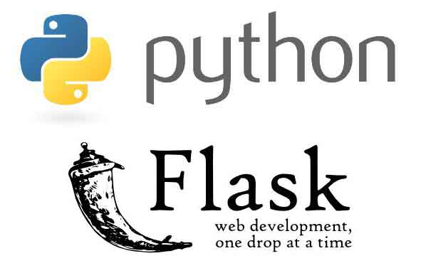
Flask
Python Microframework for Web Development
Easy way to implement RESTful API
Simple way to Interact with Database with SQLAlchemy

Slide 18

SQL Alchemy
SQL toolkit allows for full use of SQL power in simple Python adaptation
Full suite of well known enterprise-level persistence patterns
Object-Relational Mapper(ORM) allows building of Database Schema and object models in an entirely decoupled fashion

Slide 19
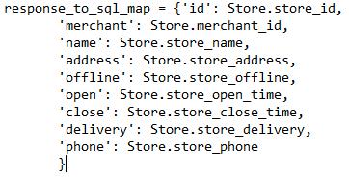
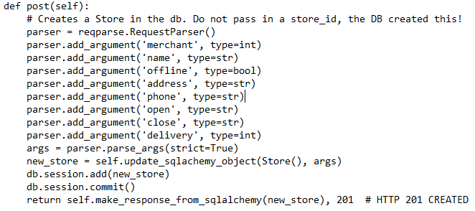
SQL Alchemy + Flask Mapping Example Code

Slide 20
Flask API Code Sample
/stores/<int:store_id>
def get(self, store_id=None): # Get a store from the DB
if store_id is None:
store_info = Store.query.all()
else:
store_info = Store.query.get(store_id)
if store_info is None or store_info == []: # Could not find that persons id
return {'status': 400, 'message': 'store_id provided does not exist'}, 400
return self.make_response_from_sqlalchemy(store_info), 200

Slide 21
http://127.0.0.1:5000/stores/3
{ "address": "123 Ocean Avenue", "close": "06:01 PM", "delivery": 0, "id": 3, "merchant": 2, "name": "Rob's Bakery", "offline": false, "open": "06:00 AM", "phone": "234-432-2343" }

Slide 22
SQL Alchemy Example
/stores/<int:store_id>/unfulfilled-orders/
def get(self, store_id):
product_ids = Product.query.filter(Product.store_id == store_id).with_entities(Product.product_id)
order_ids = OrderContent.query.filter(OrderContent.product_id.in_(product_ids)).with_entities(OrderContent.order_id)
store_order_info = Order.query.filter(Order.order_id.in_(order_ids)).filter(Order.status_id <= 2).all()
if store_order_info is None or not store_order_info:
return {'status': 400, 'message': 'No orders are associated with the store id were found.'}, 400
return self.make_response_from_sqlalchemy(store_order_info), 200

Slide 23
http://127.0.0.1:5000/stores/1/unfulfiled-orders
[{ "address": "123 gumball street", "date": "2016-11-10", "id": 1, "status": 1, "user": 1 }, { "address": "123 nowhere street", "date": "2016-11-13", "id": 5, "status": 1, "user": 1 }]

Slide 24
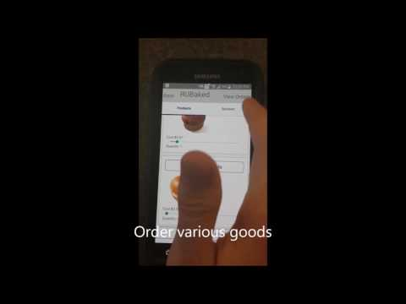
App Demo

Slide 25
Challenges
React-Native is a currently in-development project - Versions are continuously being rolled out with major changes
Typical development done in OSX or Linux environments making Windows environment tools sparse and difficult to set up.
Endpoints for API were difficult to determine due to the open-ended aspect of the features - Can always make more!

Slide 26
What We Learned
Platforms are difficult to work on when they are updated continuously throughout the development process
Testing is extremely important for applications interfacing directly with a user
Mobile development requires careful planning of both backend services AND UI features in order to build a coherent application
RESTful API services are very powerful and useful tools

Slide 27
Questions?

